Slide 1
People Rank: Social Opportunistic Forwarding

Slide 2
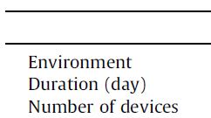
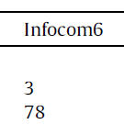
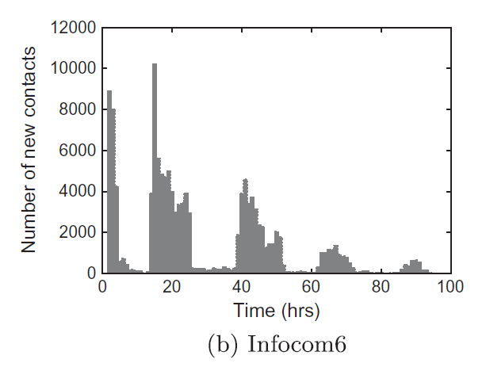
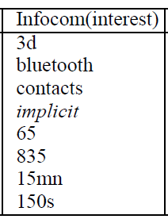
INFOCOM2006

Slide 3
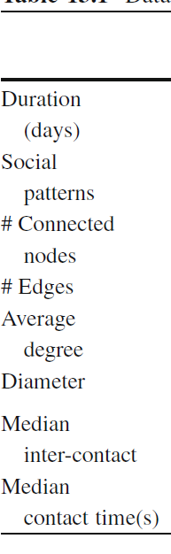
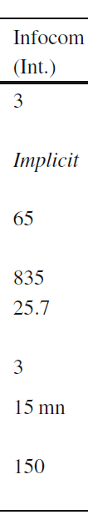
Building a social relationships between each device
Total edges = (Node*Average degree)/2
Total edges = 65*25.7/2 = 835.25
Define a social relationship between two nodes u and v if they are sharing 2 common interests.
Total degree = 1676
Edges = 838
Average degree = 25.7846

Slide 4
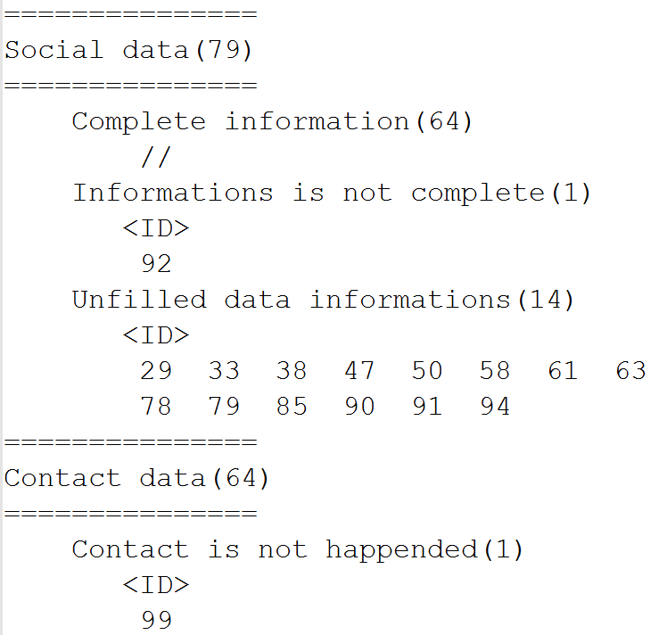
Selected devices

Slide 5
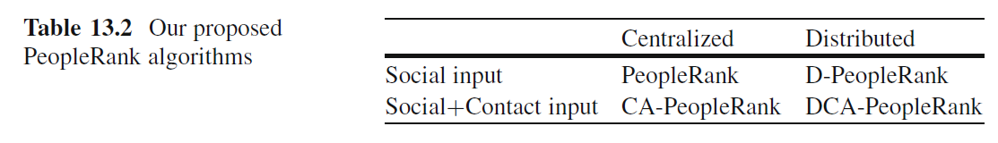
Centralized PeopleRank

Slide 6
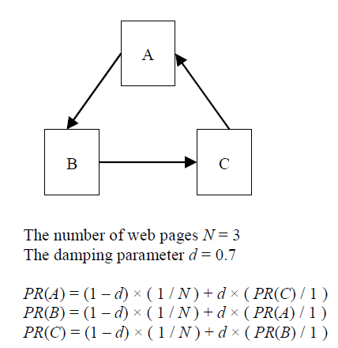
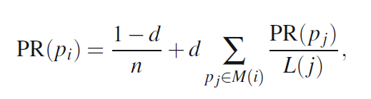
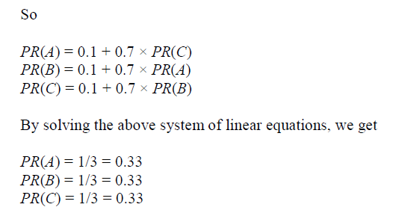
PageRank

Slide 7
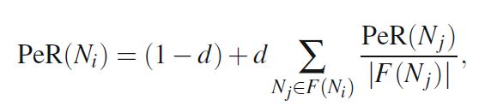
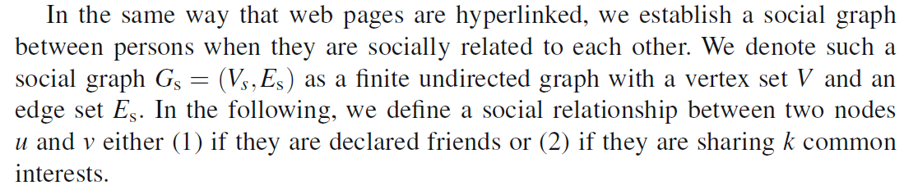
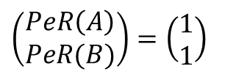
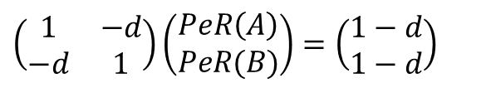
PeopleRank
A
B
PeR(A) = (1-d) + d * (PeR(B)/1)
PeR(B) = (1-d) + d * (PeR(A)/1)
$$\left(\begin{matrix}1 & −d \\ −d & 1\end{matrix}\right)\left(\begin{aligned}PeR\left(A\right) \\ PeR(B)\end{aligned}\right)=\left(\begin{aligned}1−d \\ 1−d\end{aligned}\right)$$
The number of nodes N = 2
The dumping factor is d
$$\left(\begin{aligned}PeR\left(A\right) \\ PeR(B)\end{aligned}\right)=\left(\begin{aligned}1 \\ 1\end{aligned}\right)$$

Slide 8
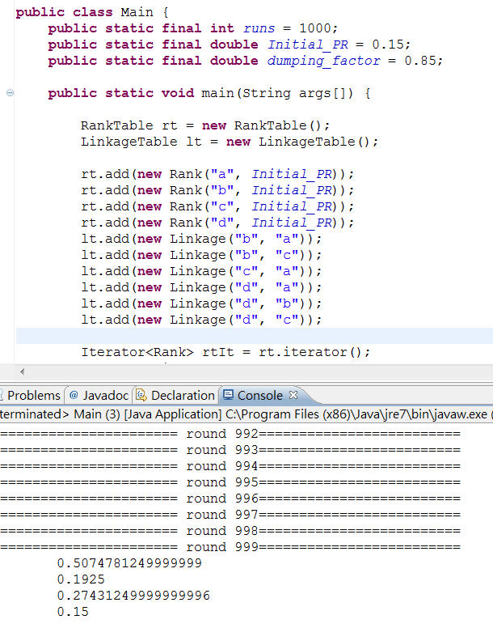
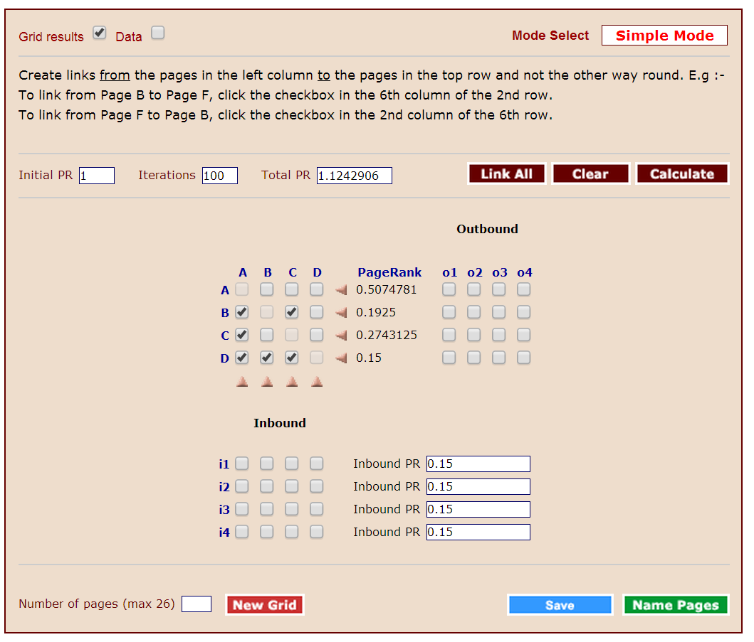
First calculate each node’s people rank value by
Testing the correctness of the program
pagerank-pc-master.zip, get it from GitHub.

Slide 9
Then Produce social graph

Slide 10
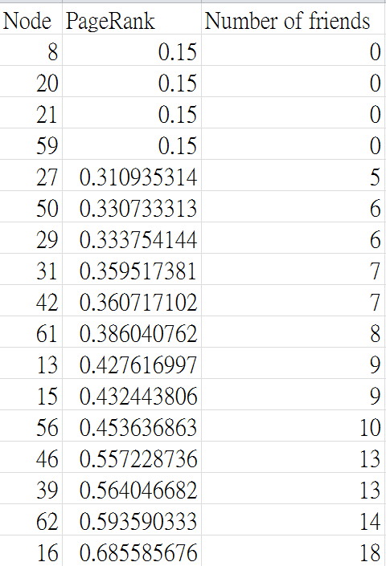
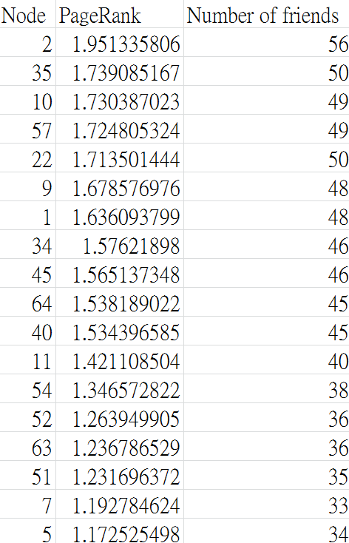
People rank value of all nodes is calculated

Slide 11
Simulation by using ONE Simulator
Scenario.StartTime = 0
Scenario.endTime = 259200
Events.nrof = 2
Events1.class = ExternalEventsQueue
Events2.class = MessageEventGenerator
Events2.interval = 260

Slide 12
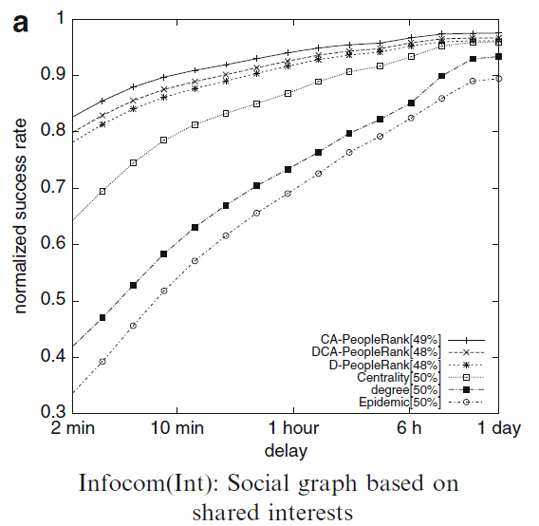
(Number of Each algorithms delivered) / (Number of Epidemic delivered)

Slide 13
Delivery prob.
Delivery cost

